Slide 1

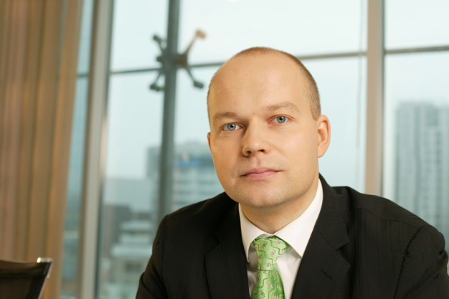
ARCO VARA webinar
Will be activated on January 31, 2013 at 16:30 (EET)
Webinar hosted by:
Tarmo Sild
Arco Vara AS
Chief Executive Officer

Slide 2
Agenda
Group overview and ongoing projects
Plans for 2013
Comments on revaluations
Notes:
2

Slide 3


Group overview
Arco Vara
(holding)
6+1
Arco Real Estate
(Estonia)
10+42
Arco Real Estate
(Latvia)
8+58
Arco Real Estate
(Bulgaria)
19
Arco Development
(Estonia)
5
Arco Development (Latvia)
1
Arco Development
(Bulgaria)
2
Facility manag.
(Bulgaria)
2
Arco Construction
(Estonia)
22+5
- Employment contracts + agency agreements & other
10+42
- subject to restructuring & stabilization
Notes:
3

Slide 4
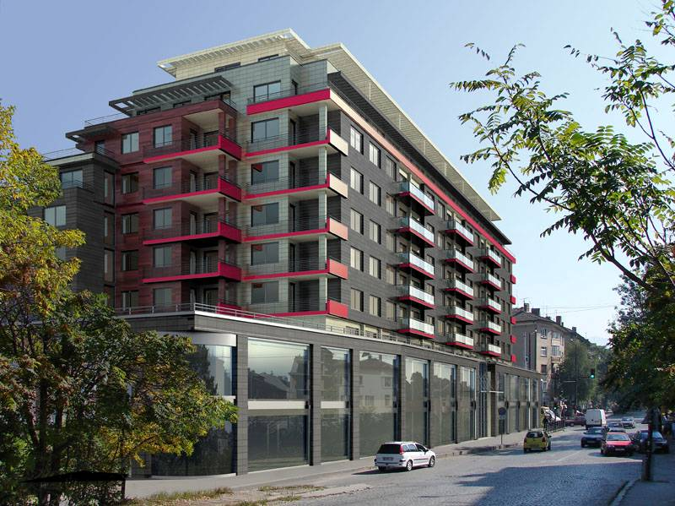
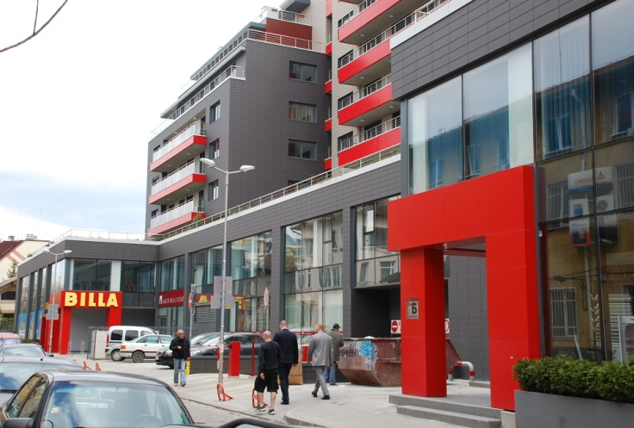
Arco Development Bulgaria
MADRID Sofia (residential, commercial product )
Completed in 2010
87 apartments in total, 10 200 m2
  52 apts. sold/booked (60%) Delivery frozen
  10 apts. cash flow (11%)
  25 apts. in stock (29%)
2 600 m2 cash flow: commercial street (88% occupied)
4 700 m2 cash flow: offices on levels 2 and 3 (100% occupied)
165 underground garage and parking place units – 37 sold/booked,
103 cash flow, 25 in stock
Current loan exposure above 13 mln eur
Intensive restructuring ongoing to stabilize situation
Notes:
4

Slide 5
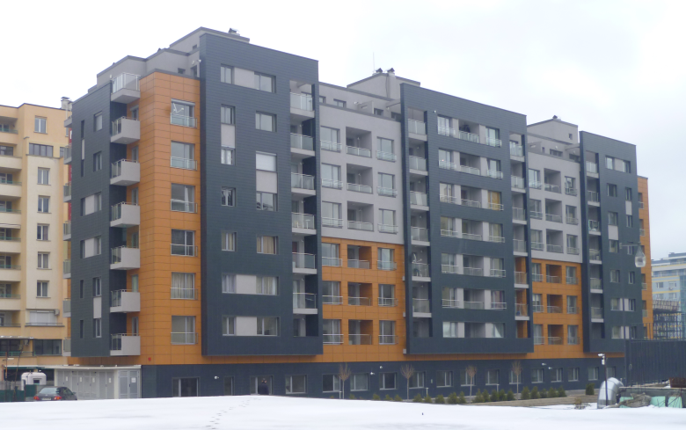
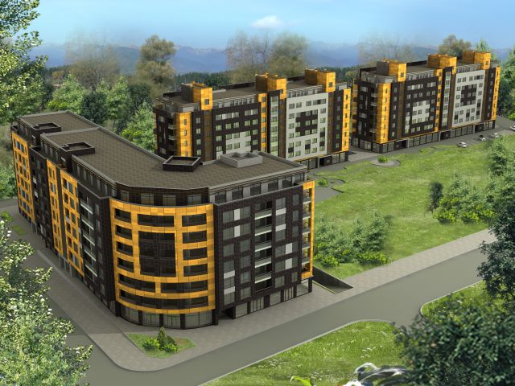
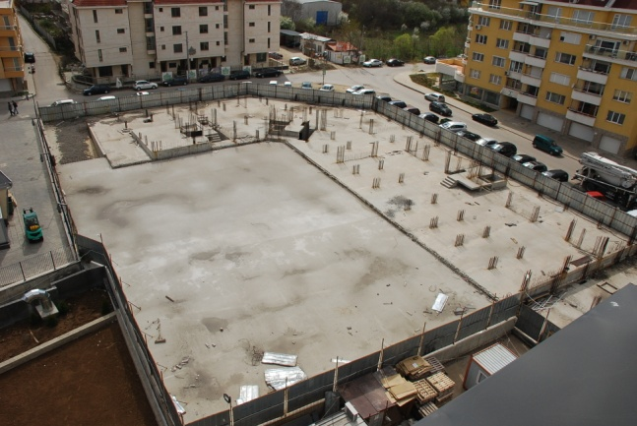
Arco Development Bulgaria
MANASTIRSKI Sofia (resid., commercial product)
Stage 1 – fully completed in April 2012
  74 apts., 6 650 m2 (63 sold/booked, 85%) Delivery frozen
  6 shops, 230 m2 (5 sold/booked, 83%)
  84 parking places (35 sold/booked, 42%)
  11 apts., 1 shop and 49 parking places in stock
Stages 2 and 3 – completed at 0-level
  210 apts., 18 300 m2
  19 shops, 1 200 m2
  138 parking places
Loan exposure over 2 mln eur,
subject to intensive restructuring
and stabilization
Notes:
5

Slide 6
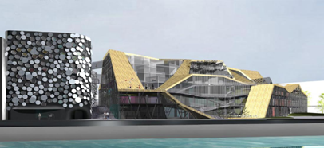
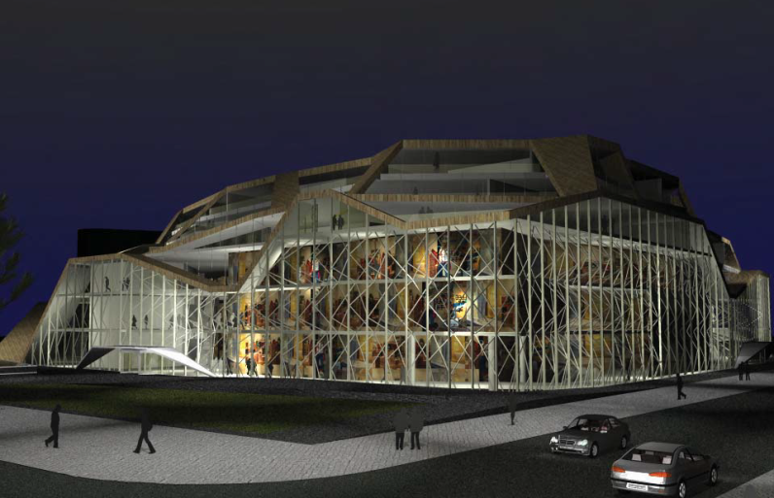
Ahtri 3 Arco Development Estonia
Tallinn (multi-purpose development)
Land area 13 900 m2
Building rights obtained for 51 110 m2
JV (50/50) Arco HCE with U.S. Real Estate Management
Current liability of Arco HCE before Danske Bank over 12 mln eur
Business plan development in process
Subject to intense restructuring and legal proceedings
Collateral issued by Arco Investeeringute AS to Danske Bank in
amount of 1.9 mln eur is fully provisioned
Notes:
6

Slide 7
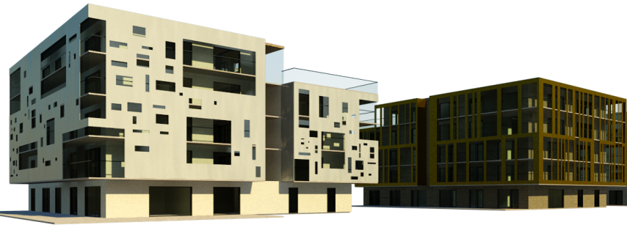
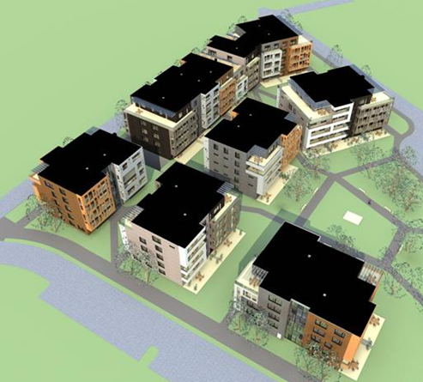
Tivoli Arco Development Estonia
Tallinn (residential development)
Land 48 588 m2
I phase - gross building right 16 100 m2,146 apts.
JV (50/50) with International Invest Project OÜ (IIP)
13 mln eur construction contract signed in May 12, delays in
performance by Construction Company
Arco Vara AS collateral to IIP in maximum amount of 5.6 mln eur;
provisioned in amount of 1 mln eur
Tivoli Arendus OÜ current liability before partner IIP is exceeding 8 mln
eur
Subject to intense restructuring
Notes:
7

Slide 8
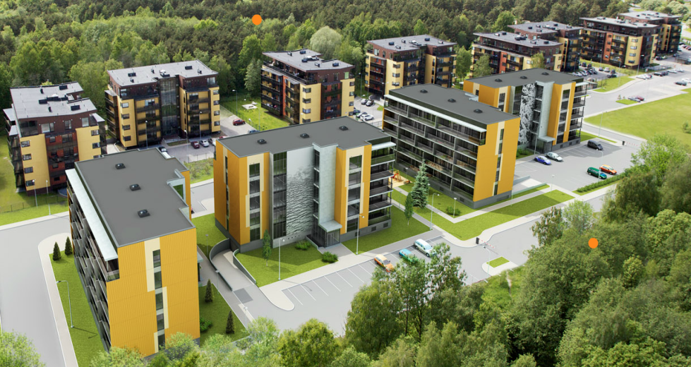
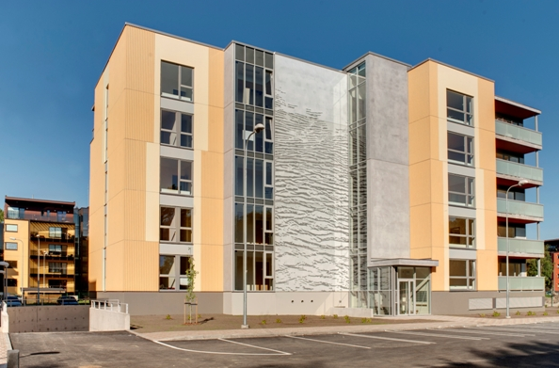
Arco Development Estonia
KOLDE Tallinn (residential development)
248 ap. completed earlier (sold out)
50 ap. completed in spring 2011(sold out)
48 ap. completed in June 2012 (5 in stock)
Notes:
8

Slide 9
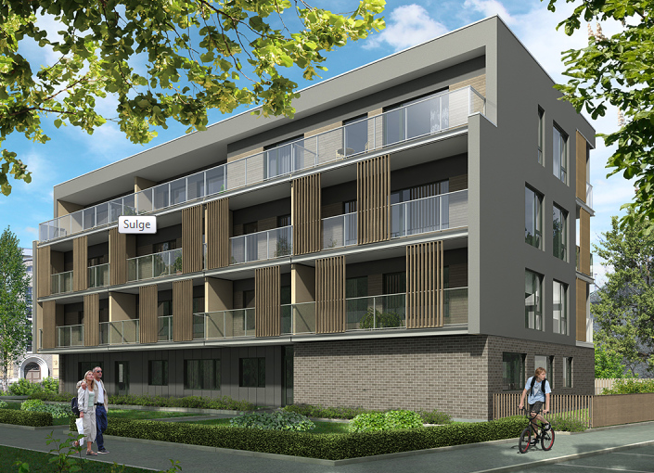
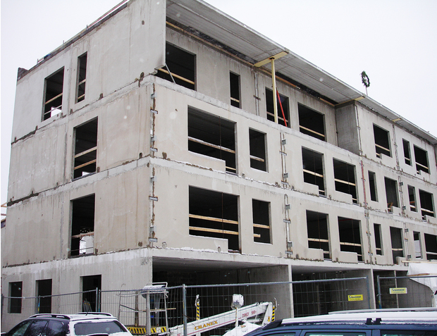
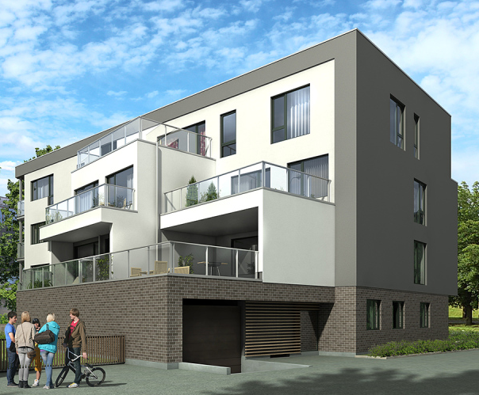
Arco Development Estonia
TEHNIKA 53 Tallinn (residential development)
Sellable area 1118 m2
Construction in progress
Delivery in July 2013
12 from 14 apartments are presold (85%)
Notes:
9

Slide 10
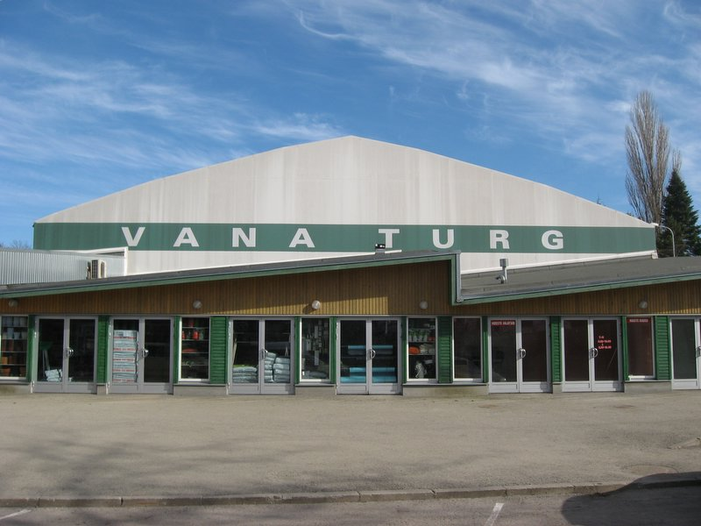
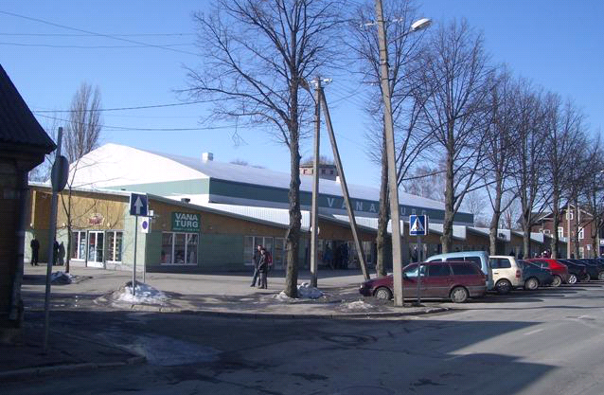
Arco Development Estonia
PÄRNU TURG Pärnu (cash flow)
Market place in center of Pärnu
Size of land plot 7 700 m2
Market hall with GLA 2 500 m2
Over 90 tenants
Indoor vacancy 9%
Very stable financial result throughout economic cycle
Sale is possible, subject to price
Notes:
10

Slide 11
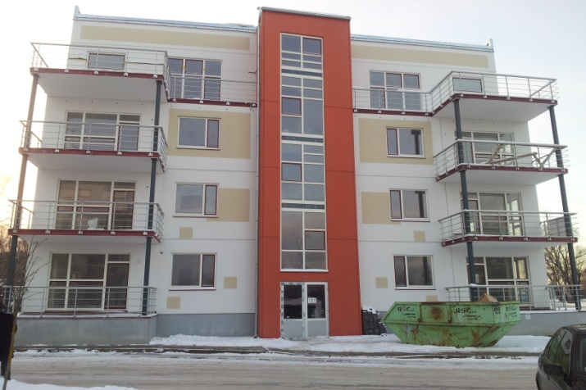
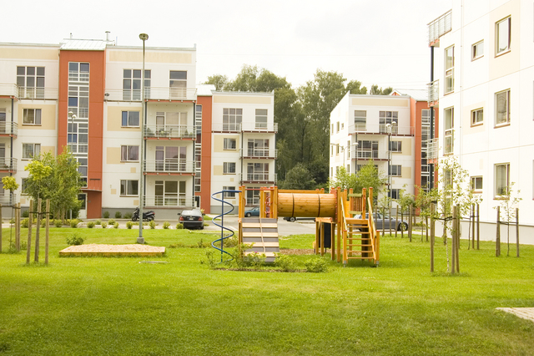
Arco Development Latvia
BIŠUMUIŽA1 Riga (residential development)
9 houses with 126 apartments
98 apts. are ready and sold earlier
2 houses with 28 apts.(1 920 m2) are in semi product phase
(Kometas 2 & 4)
14 apts. construction relaunch & completion planned by II HY 2013
Notes:
11

Slide 12
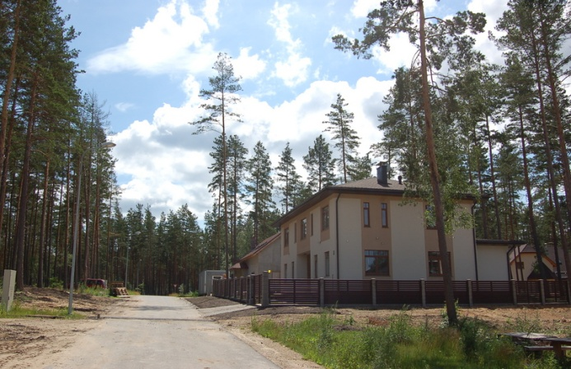
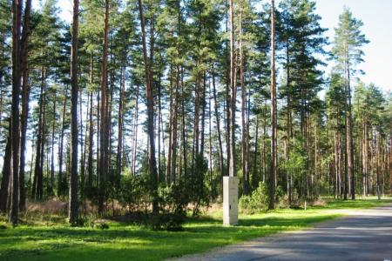
Arco Development Latvia
BALTEZERS 5 Close to Riga (residential land)
29 developed land plots total
22 plots remaining in stock (43 500 m2)
BALTEZERS 3 Close to Riga (residential land)
68 undeveloped land plots
total sellable area 11 ha
property registration pending
Notes:
12

Slide 13
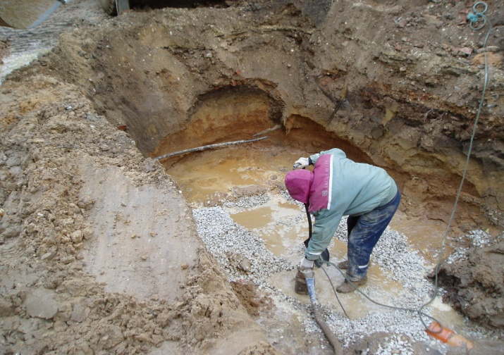
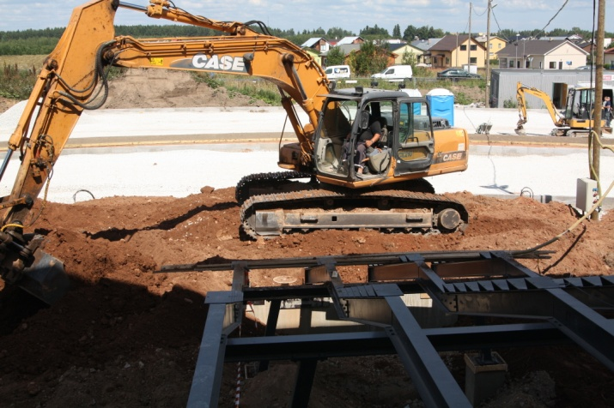
Arco Construction Estonia
1. OBJECTIVE
to complete the two ongoing projects with small operating profit:
Kuusalu public water and wastewater network (remaining balance 1.2 mln eur)
Paide wastewater treatment plant (remaining balance 1.4 mln eur)
Works are in progress, on schedule, 100% completion in November 2013.
2. OBJECTIVE
to clarify past irregularities, collect all receivables and serve all debt payables (incl finished projects). Several legal proceedings pending.
Notes:
13

Slide 14
Arco Vara plans for 2013
Stabilize the situation (development projects)
Complete pending constructions by Arco Ehitus
Brokering and valuations as usual
Introduce integrated production process
Produce & sell 1000-2000 sqm apartments in Latvia
Produce & sell 1000 sqm of apartments in Estonia
Prepare new development portfolio for 2014 in Est, Lat, Bul and relaunch production!
SHARE ISSUE POSSIBLE, BUT WITH PURPOSE TO FINANCE PRODUCTION ONLY
Notes:
14

Slide 15
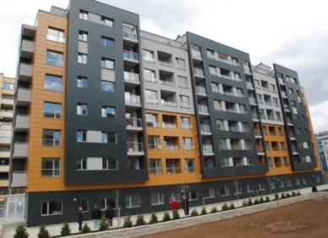
Integrated production process
Market research
Marketing
Planning & design
Finance manage- ment
Develop-ment
Sale
Facility manage-ment
Apartment =
Notes:
15

Slide 16
Arco Vara project information layout
2013 1Q | Project type | In preparation | Under development | In Stock | Cash flow project | TOTAL
ESTONIA | apts./plots | XX m2 | Xx m2 | Xx m2 |  | Xx m2
 | cash flow | XX m2 | XX m2 |  | Xx m2 | XX m2
LATVIA | apts./plots | XX m2 | Xx m2 | Xx m2 |  | Xx m2
 | cash flow | XX m2 | XX m2 |  | Xx m2 | XX m2
BULGARIA | apts./plots | XX m2 | Xx m2 | Xx m2 |  | Xx m2
 | cash flow | XX m2 | XX m2 |  | Xx m2 | XX m2
TOTAL |  | XX m2 | Xx m2 | Xx m2 | Xx m2 | Xx m2
In preparation – incl. market research, marketing, DP and design. Roughly estimated sqm information.
Under development – finance arranged, construction started. Quite accurate sqm information.
In stock – Developed apartments and plots on sale. Exact sqm information, based on stock.
Cash-flow project – Developed project is serving annual cash-flow. Exact sqm information.
Starting with new layout in 1Q 2013
Notes:
16

Slide 17
Valuation process
When? - annual revaluation process was taken place during 01.11.2012 - 10.01.2013
Who? - undertaken by managers, specialists, legal counsels and auditors of Estonia, Latvia & Bulgaria
How? - sales comparison, residual value and discounted cash flow methods were used
Outcome? - receivables were written down by 3.46 mln eur, inventories & inv. properties written down by 14.25 mln eur and provisions increased by 1.96 mln eur
Totally equity decreased by 19.67 mln eur with 31.12.2012
Change in valuation bases or in events in 2012? – change in valuation base formed up to 75% of the total write-down of inventories and investment properties, change in events of 2012 formed rest of 25%

Slide 18
The impact of valuation to assets and liabilities
Change in th euros | Receivables | Inventories & inv. properties | Provisions | TOTAL
Estonia | -3 462 | -1 302 | - 1 959 | -6 724
Latvia |  | -3 163 |  | -3 163
Bulgaria |  | -9 779 |  | -9 779
TOTAL | -3 462 | - 14 245 | -1 959 | -19 666
Principal differences in valuation 2012 vs 2013:
2013: apartments and plots classified as inventories and plots classified as investment properties are in their possible sales price during a roughly one-year realization period
2012: plots classified as investment properties included possible future income from the development of the plots into the end product. Sales period of apartments in inventories was not restricted with one year

Slide 19
Q&A time
Please use the Chat pod on your right side of the screen
Notes:
19

Slide 20
Thank you!
Tarmo Sild
Arco Vara AS
Chief Executive Officer
Phone: +372 614 4630
tarmo.sild@arcovara.ee
http://www.arcorealestate.com

