Slide 1
Q2 and HY1 2009 results
July 2009

Slide 2
Management commentary to Stock Exchange about Q2 2009 results
The Group’s sales revenues in the second quarter were primarily impacted by regulations (European Union regulations applied on the mobile sector) and the economic downturn (reduction of sales of goods and changes in consumer behavior). At the same time, there is a continuing growth of mobile postpaid, mobile and fixed broadband and TV customers.

Slide 3
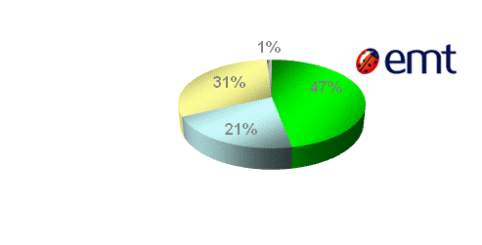
EMT’s market position
 | June 2009 | June 2008 | +/-
Mobile postpaid users (in th.) | 484,0 | 480,0 | 4,0
EMT’s estimated market share (by number of active SIM-cards) was 47%

Slide 4
Elion’s market position
 | June 2009 | June 2008 | +/-
No of permanent Internet connections (in th.) | 175,2 | 168,3 | 6,9
No of IP and cable-TV customers (in th.) | 88,4 | 67,7 | 20,7
Total means of communication (in th.) | 460,0 | 473,0 | -13,0

Slide 5
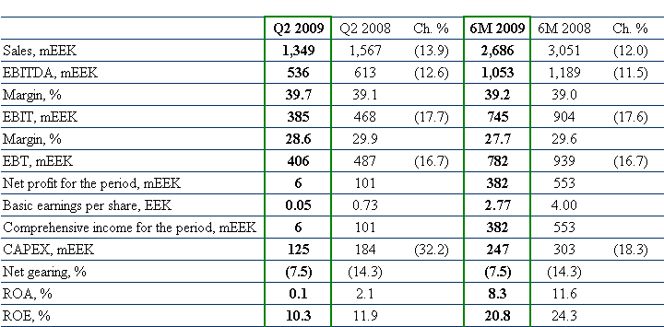
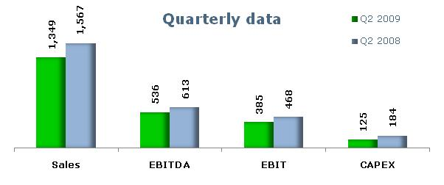
Financial results Eesti Telekom Group

Slide 6
Dynamics of sales
Continued customers’ growth in broadband services and mobile communication segments;
Sales revenues were primarily impacted by regulations that EU applies to the mobile sector and by the economic downturn

Slide 7
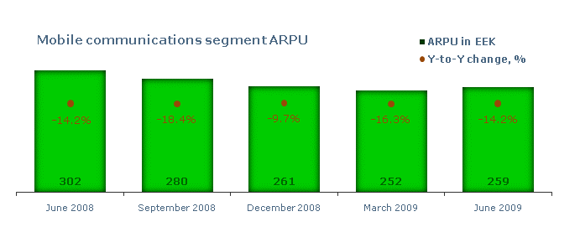
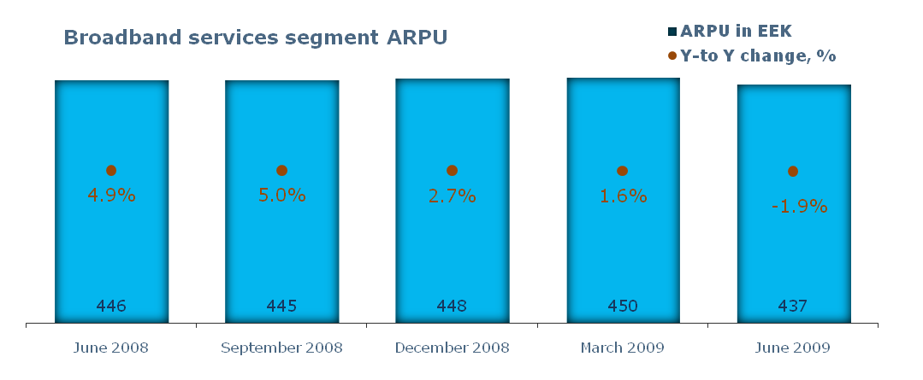
ARPU

Slide 8
Dynamics of OPEX
Decline in retail and wholesale volumes
Significant impact of efficiency projects to IT, maintenance and personnel costs

Slide 9
Dynamics of EBITDA

Slide 10
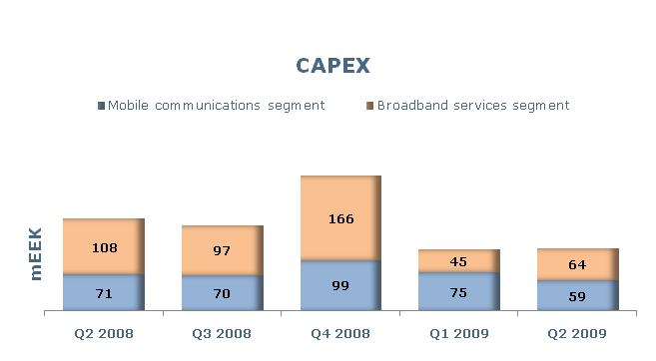
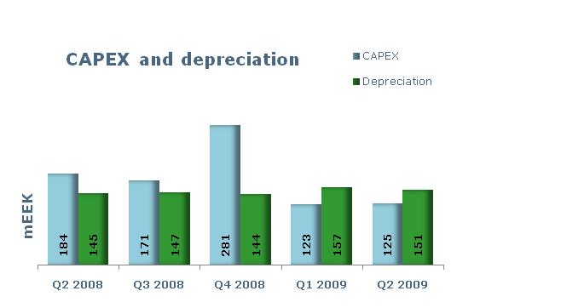
CAPEX and depreciation
Investing priorities:
Broadband
Development of network resources, changes in the product portfolio, the improvement of and expansion of the availability of the triple-service packages
Mobile
Implementation of technologies supporting high-speed data communications;
IT
Expansion of the infrastructure necessary for the provision of services

Slide 11
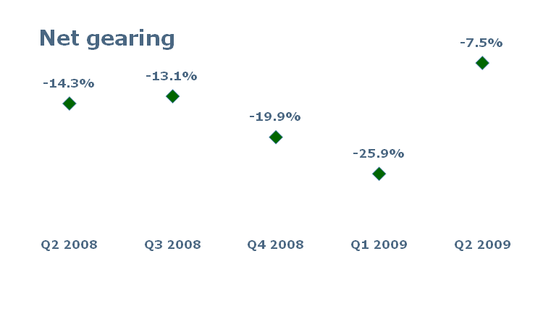
Cash position
Eesti Telekom group paid dividends on 16 June 2009: 10.50 EEK per share;
In total, 1,449 mln EEK was paid out.

Slide 12
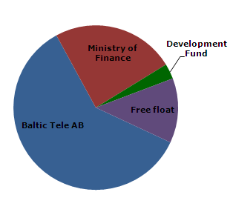
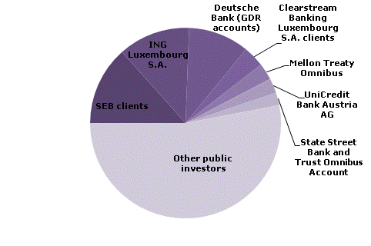
Largest shareholders of AS Eesti Telekom

Slide 13
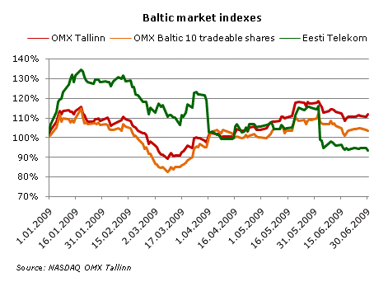
Trading statistics in Tallinn
SHARE INFORMATION
Veerg1 | 2005 | 2006 | 2007 | 2008
Year-end number of shares | 137,954,528 | 137,954,528 | 137,954,528 | 137,954,528
Annual average number of shares | 137,954,528 | 137,954,528 | 137,954,528 | 137,954,528
Equity per share, EEK | 29.28 | 29.78 | 31.19 | 31.08
Earnings per share, EEK | 7.88 | 9.49 | 10.91 | 10.40
P/E ratio | 15.1 | 13.8 | 11.2 | 5.9
Dividends per share for the year, EEK | 9.00 | 9.50 | 10.50 | 10.50
Dividend payout ratio, % | 114.2 | 100.1 | 96.2 | 101.0
AS Eesti Telekom has been listed on the Tallinn and London Stock Exchanges (OMX:ETLAT/LSE:EETD) since 1999.
TRADING HISTORY ON THE TALLINN STOCK EXCHANGE (in EEK)
Veerg1 | 2005 | 2006 | 2007 | 2008 | 6M 2009
High | 134.56 | 131.43 | 168.51 | 125.02 | 85.27
Low | 111.09 | 108.74 | 102.80 | 59.61 | 64.15
Last | 118.91 | 131.43 | 122.04 | 61.02 | 67.91
Change, % | 5.56 | 10.53 | -7.14 | -50.00 | 11.29
Traded volume | 23,749,354 | 19,336,241 | 23,693,032 | 17,636,495 | 5,017,457
Turnover, mln | 2,907.63 | 2,327.76 | 3,025.48 | 1,822.37 | 379.52
Capitalisation, mln | 16,404.66 | 18,131.56 | 16,836.45 | 8,418.23 | 9,454.02
Source: NASDAQ OMX Tallinn

Slide 14
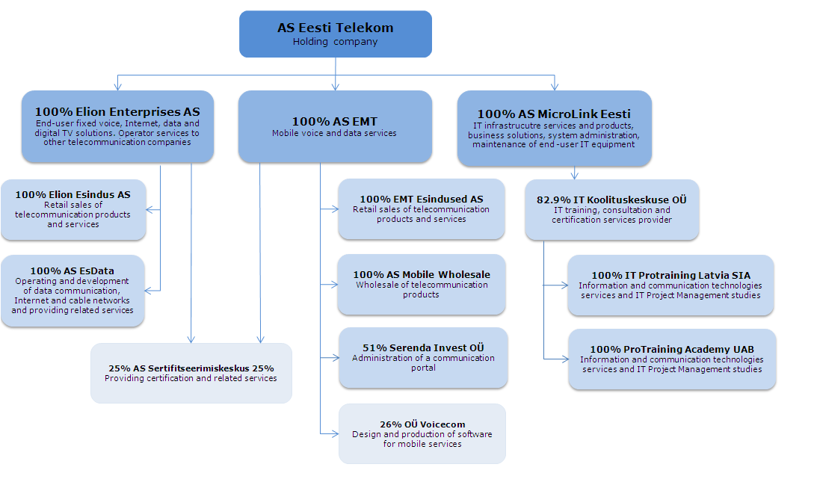
Structure of the Group

